Slide 1

Prediction of Diabetes
ATUL
19-05-2021

Slide 2
Data can be downloaded from Kaggle provided by PIMA India.
-

Slide 3
First we import required libraries
import numpy as np
import pandas as pd
import matplotlib.pyplot as plt
import seaborn as sns
sns.set(color_codes=True)
%matplotlib inline

Slide 4
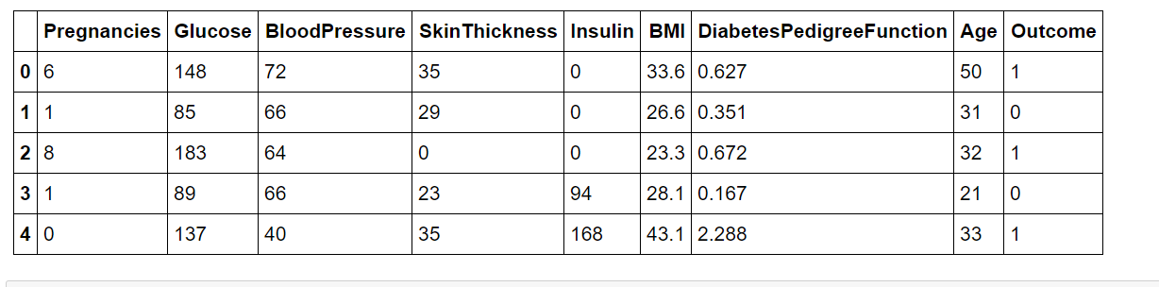
Methodology
Dataset and Attributes

Slide 5
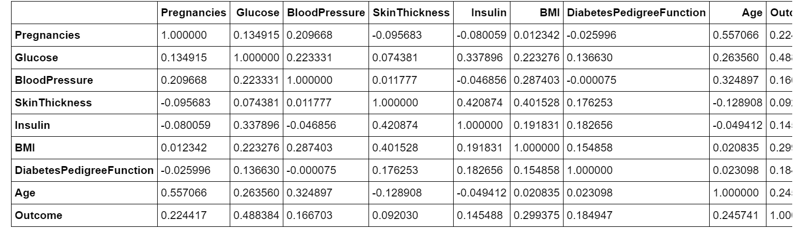
It is good to check co-relation between the features

Slide 6
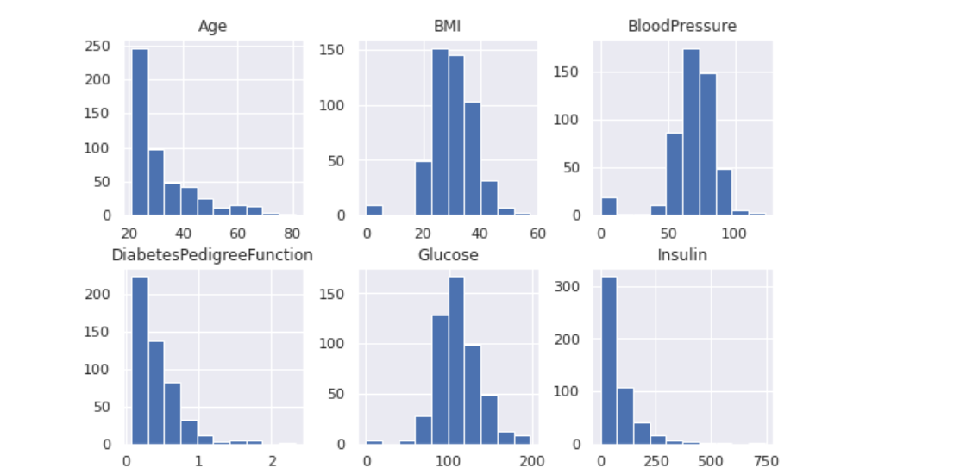
Next we visulaize the data through histogram to get a sense of data distribution

Slide 7
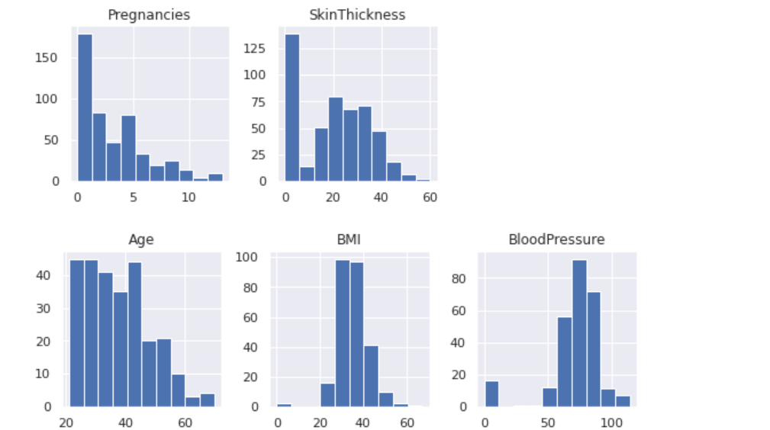
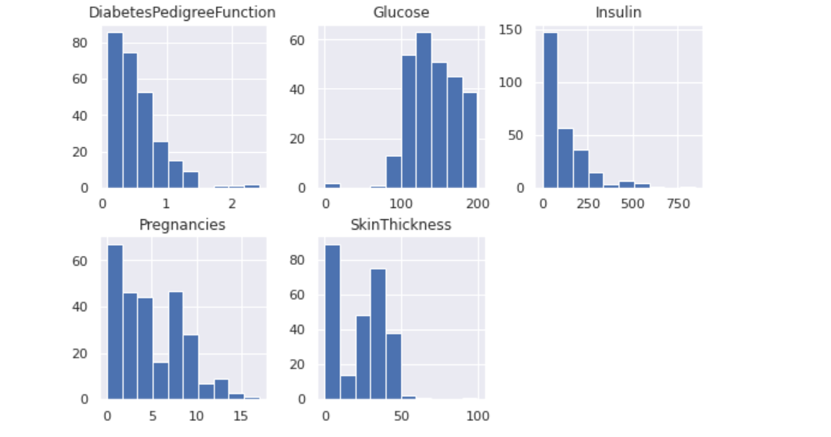
From the histograms we can observe that many patients have zero BMI,bloodpressure,glucose,insulin,skin thickness but we cannot cannot remove features like insulin and skin thickness because we will loose a valuable informations and we also cannot replace by mean value because suppose we replace blood pressure with mean value then it will send wrong message to the model.For insulin and skin thickness we also cannot remove zero values because they consist of major part of the data.So we will only remove that rows for which all together values pf bmi,bloodpressure and glucose are zero.

Slide 8
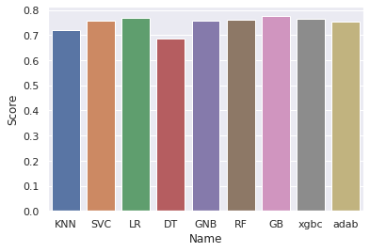
Applying classification techniques like knn, XGBoost and AdaBoost. After that we find accuracy through accuracy score and k-fold cross validation score. Below is the bar graph showing comparison between different models accuracy find through k-fold validation.

Slide 9
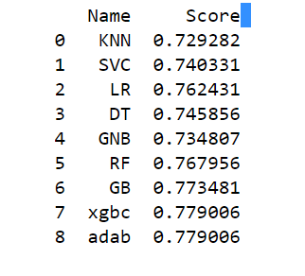
Accuracy of different models using accuracy score

Slide 10
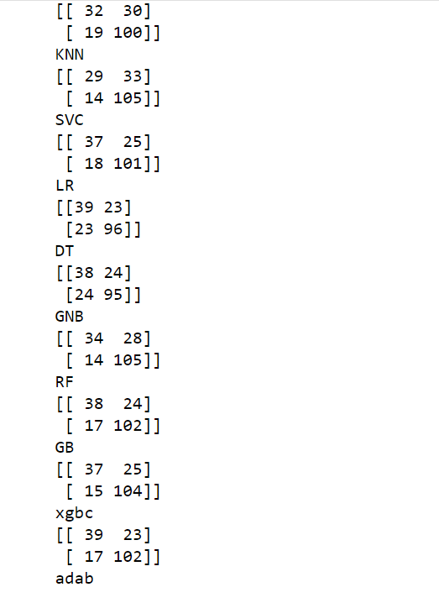
Confusion Matrix of classifiers

Slide 11
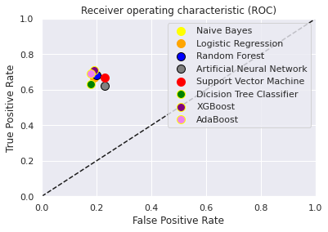
Roc Curve

Slide 12
Conclusion
In this work we have investigated the early prediction of diabetes using 9 popular classification techniques : Knn, Svm(support vector machine), Linear Regression, Decision Tree, Gradient Boost,Random forest, XGBoost, AdaBoost and GaussianNB.
The technique which accomplishes the highest accuracy is considered to be the best choice.
We can observe that XGBoost and AdaBoost have best accuracy that have obtain using accuracy score.

Slide 13
THANK YOU

